Slide 1
Embedded System Project (EET4100) External Lab Project on Digital Tachometer
Presented by
Tashmin Mishra (1641016433)
Feecon Behera (1641016437)
Kishan Kumar Singh (1641016394)
Subham Kumar (1641016486)

Slide 2
Problem Statement
To design a Digital Tachometer using 8051 microcontroller.
12/06/2019
<number>
Notes:
<number>

Slide 3
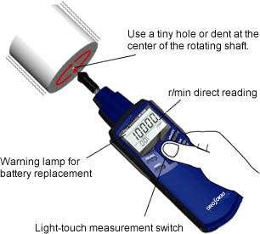
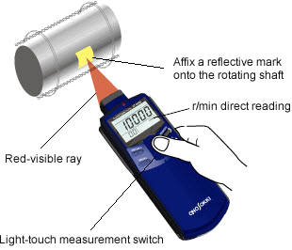
What is a Tachometer ?
An instrument which measures the rotation speed of a shaft or disk, as in a motor or other machine in RPM.
Types:
Contact type
Need contact with rotor of motor or wheel
Con tactless type
No need for contact with rotor and need sensors.
12/06/2019
<number>

Slide 4
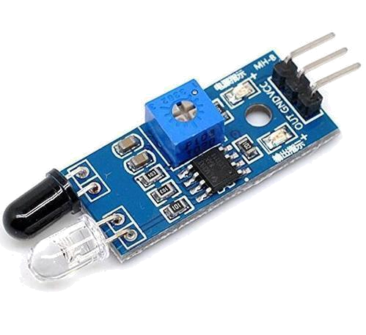
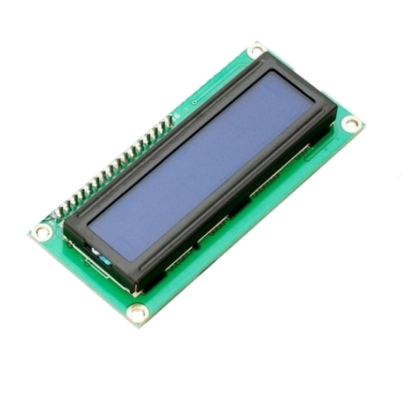
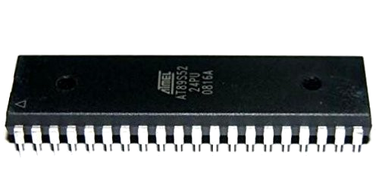
Hardware Design
This project consist of three units:-
Sensing unit (IR Sensor)
Controlling unit (8052 Microcontroller)
Displaying unit (16x2 Display)
IR Sensor
8051 Microcontroller
16x2 Display
12/06/2019
<number>

Slide 5
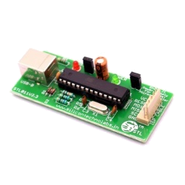
Hardware Interface
USB ISP Programmer:
6 pin out: VCC, GND, MOSI, MISO, SCK, RESET connected with pin 40,20,6,7,8,9 of 8051 respectively.
Hex file is uploaded through ISP programmer.
Operated with 12 MHz Oscillator
12/06/2019
<number>

Slide 6
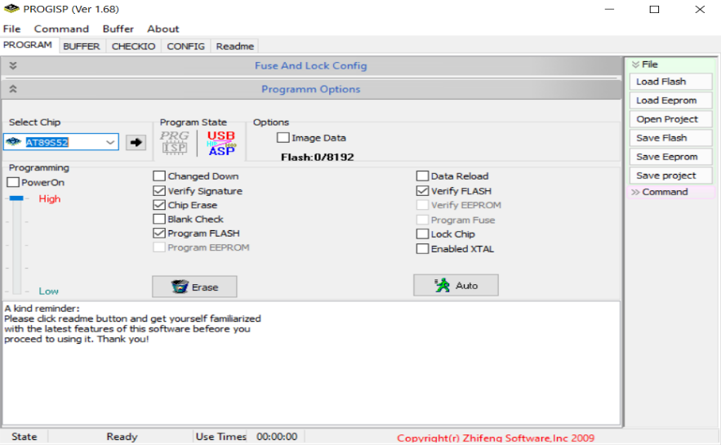
12/06/2019
<number>

Slide 7
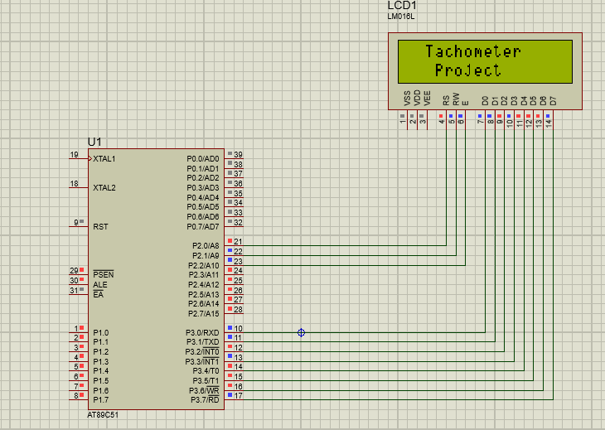
Schematic of the Hardware
12/06/2019
<number>

Slide 8
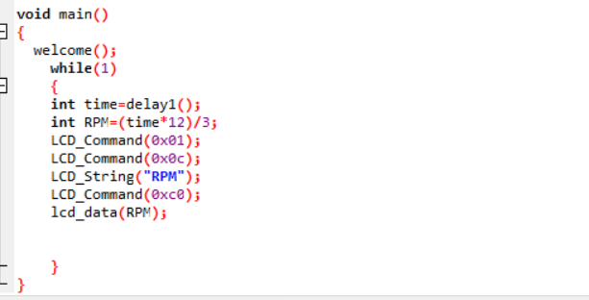
IR Sensor
(Input data)
Processing
(Calculation of RPM)
Displaying Unit
Software Design
12/06/2019
<number>

Slide 9
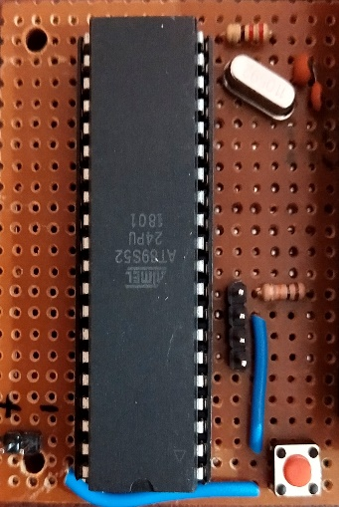
Implementation
Implementing Microcontroller:
11.0952 Mhz oscillator with 33pf capacitor configuration.
10mF with 10kohm RC circuit.
Button for reset.
12/06/2019
<number>

Slide 10
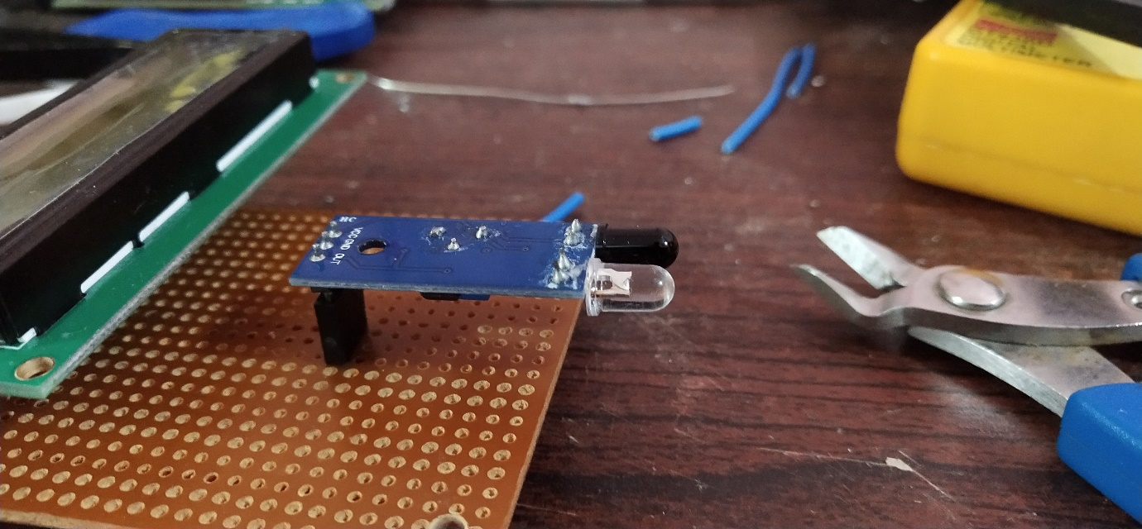
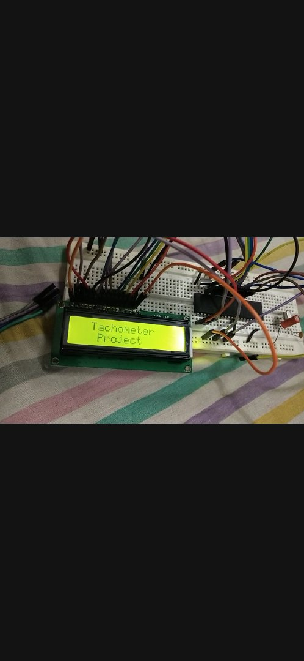
Implementing IR sensor and Display:
3 pins Vcc,GND,OUT
Out pin connected to P1^0
Diode pin connected to P3
RS,RW,EN connected to p2
12/06/2019
<number>

Slide 11
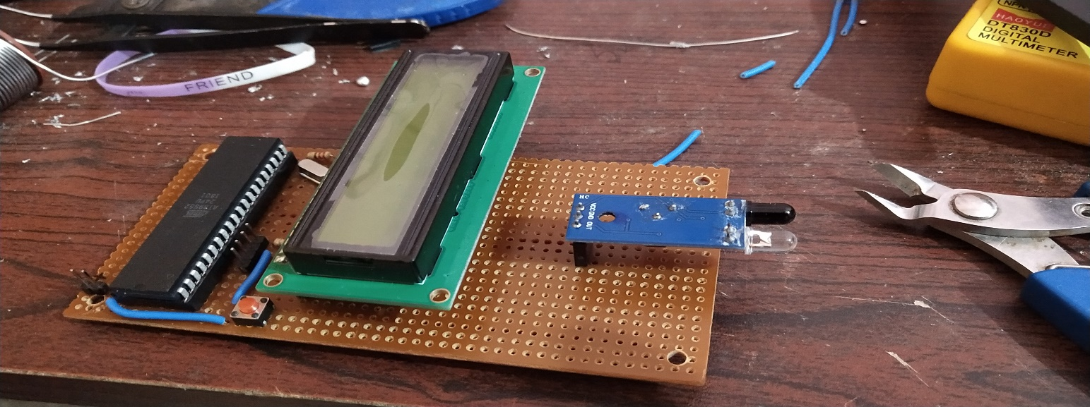
Final Implementation
12/06/2019
<number>

Slide 12
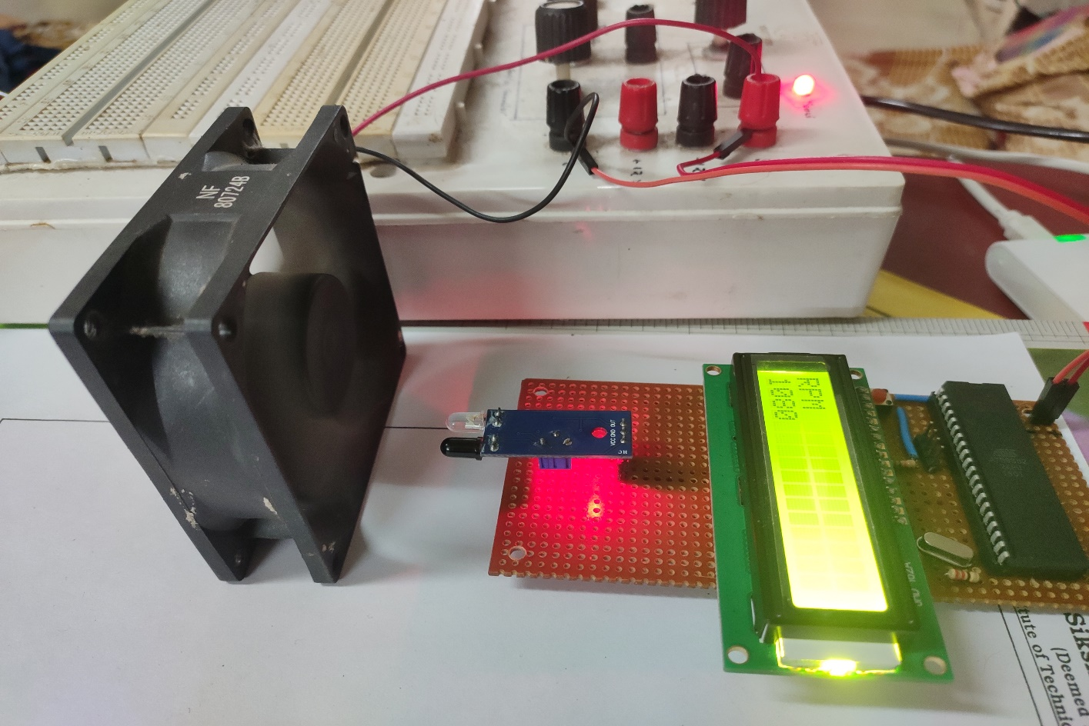
TESTING
Reflecting surface made on blade of a fan.
IR sensor placed in front of reflecting surface to operate.
12/06/2019
<number>

Slide 13
RESULTS and DISCUSSION
At the end a rotating fan is used where a white spot with black background so that the IR sensor can detect that and send a high value at that particular spot. The fan is faced against the sensor for the operation that is to measure the RPM.
This experiment was repeated more than once to check for consistency and errors and accordingly changes were made.
After continued testing and error correction we got the RPM to be around 1080 which was being successfully displayed on the screen.
12/06/2019
<number>

Slide 14
PROBLEMS & CHALLENGES FACED
Chip Enable Error – This is the error we were getting while uploading any program to AT89S552.Later we fixed this by pulling down the RESET pin of the microcontroller to GND using a 10K resistor.
Too Much Contrast in LCD Display – Initially it was very difficult to distinguish the characters displayed on the LCD which was successfully resolved to an acceptable level by putting a 5K resistor in between GND and Pin 3 of the LCD.
TimeKeeping - Basically to measure the RPM we had to find the duration between two continuous HIGH signals sent by the IR sensor and then calculate the RPM but using Timers wasn’t easy and the time duration was really small so what we did was we took duration over a constant period of time and also kept track of number of times the signal changed which at the end yielded the RPM.
12/06/2019
<number>

Slide 15
CONCLUSIONS AND RECOMMENDATIONS
So at last we can conclude that this Digital Tachometer works and achieves it’s goal of measuring RPM i.e. Revolutions Per Minute.
But we can improve this by getting a faster microcontroller as we suspect it might not work for faster microcontrollers. Also now it doesn’t measure the RPM on the fly but can will be an improvement and make it dynamic.
12/06/2019
<number>

Slide 16
REFERENCES
[1] Shirriff, Ken (30 August 2016). "The Surprising Story of the First Microprocessors". IEEE Spectrum. Institute of Electrical and Electronics Engineers. Retrieved 13 October 2019.
[2] Heath, Steve (2003). Embedded systems design. EDN series for design engineers (2 ed.). Newnes. pp. 11–12. ISBN 9780750655460.
[3] Erjavec, Jack (2005). Automotive Technology. ISBN 1-4018-4831-1.
[4] "Tachometer - Facts from the Encyclopedia - Yahoo! Education". Education.yahoo.com. Archived from the original on 2012-11-06. Retrieved 2012-06-05.
12/06/2019
<number>

